Slide 1
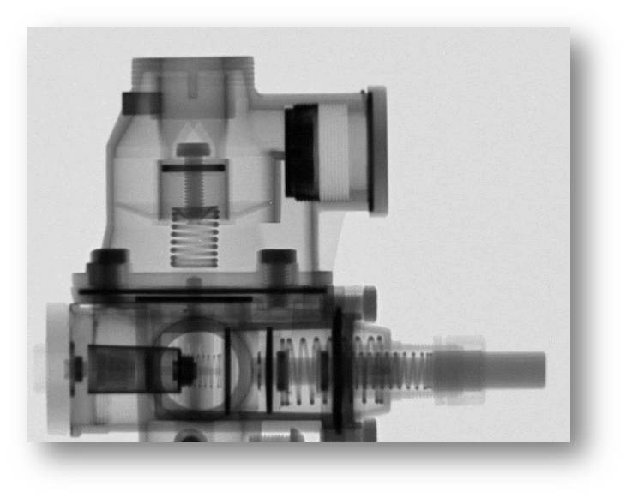
Development of Neutron Imaging Facilities at FRM II

Slide 2
Outline
Introduction
Neutron Imaging Facilities at FRM II
Comparison ANTARES I and New ANTARES II
ANTARES II – New Features
ANTARES II – Assembly
Lessons Learned and Outlook

Slide 3
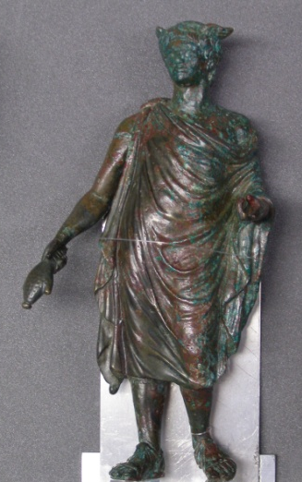
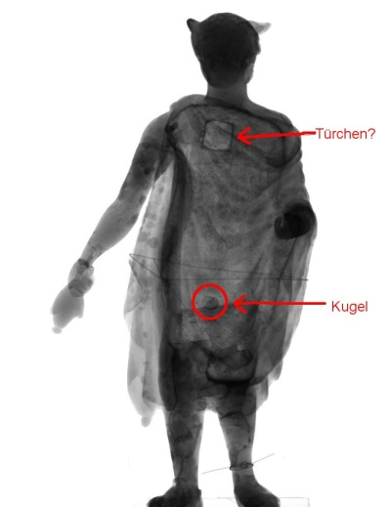
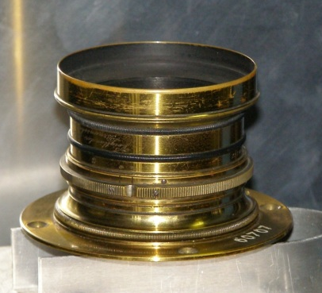
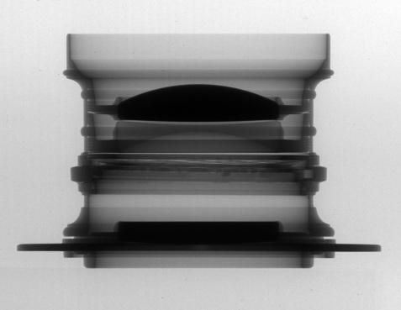
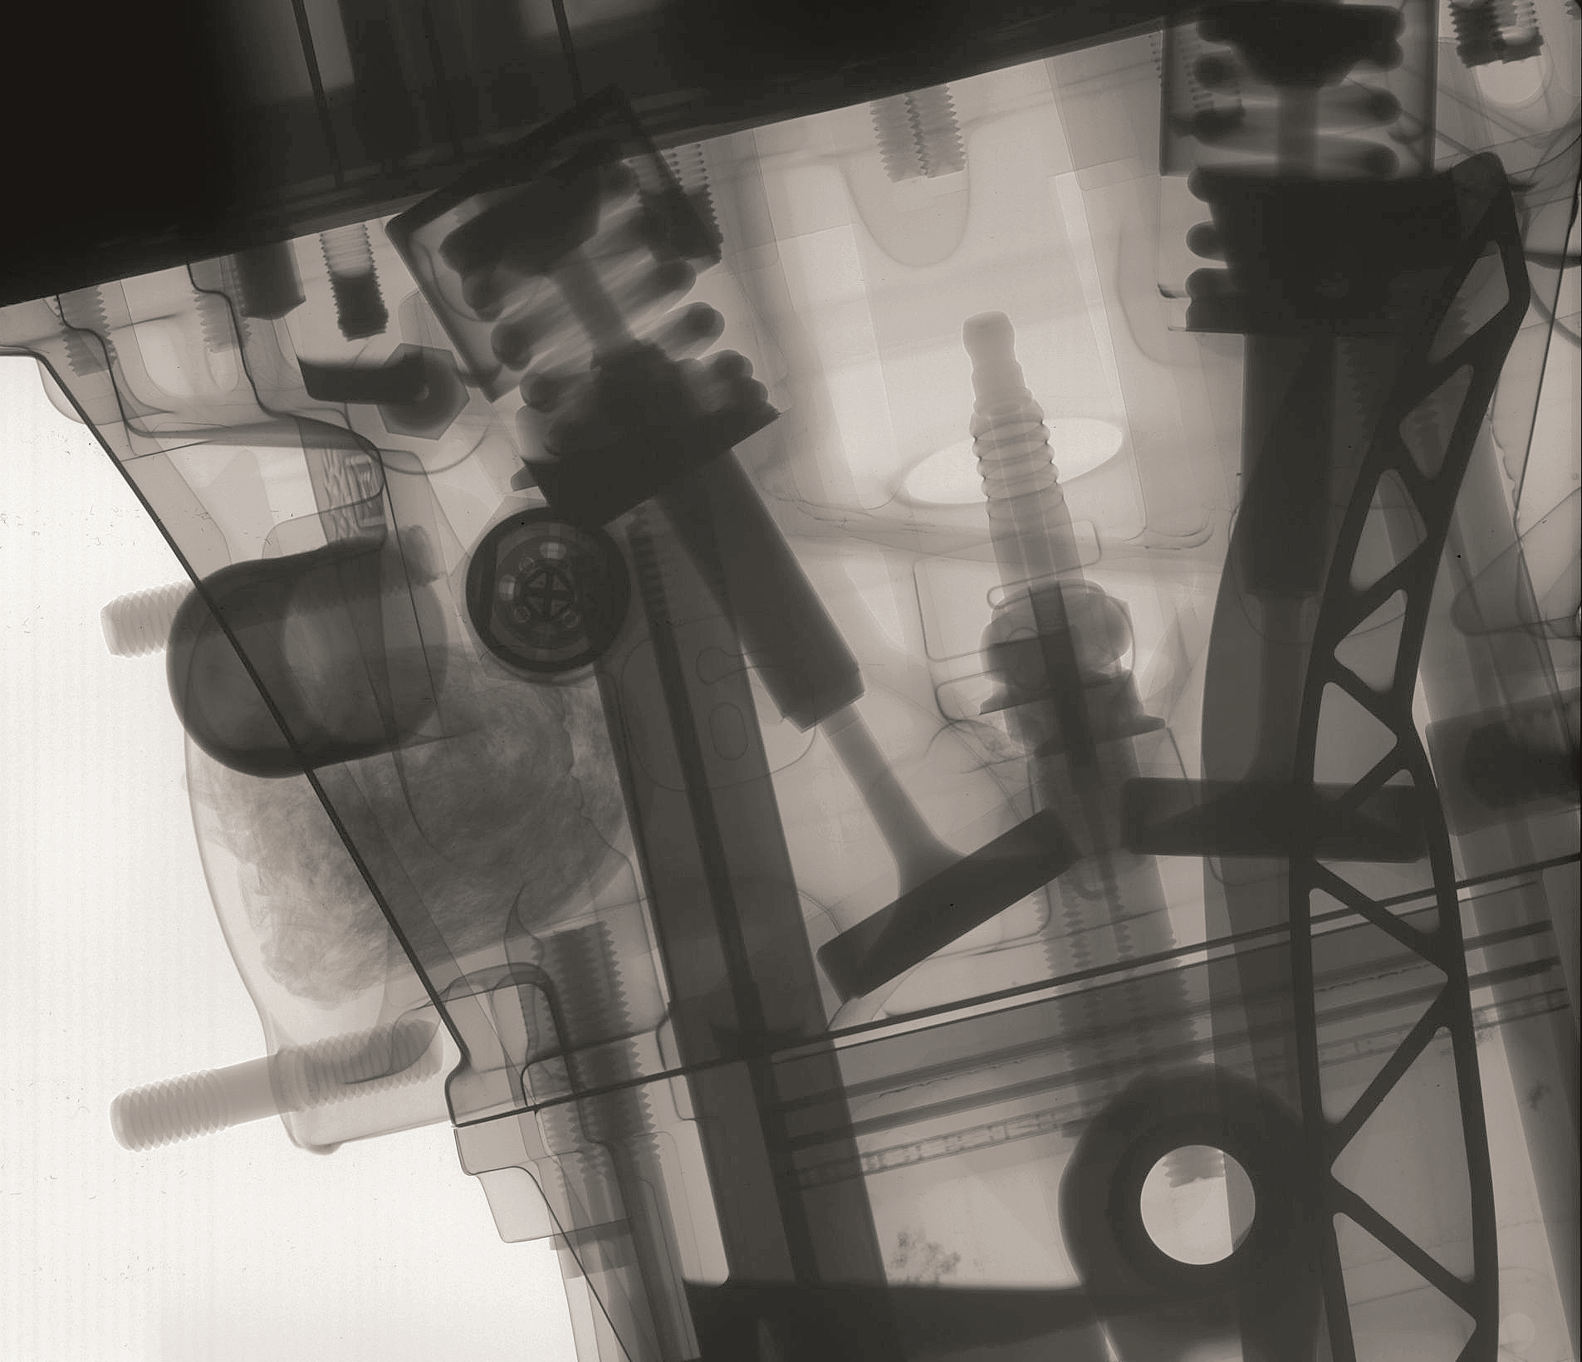
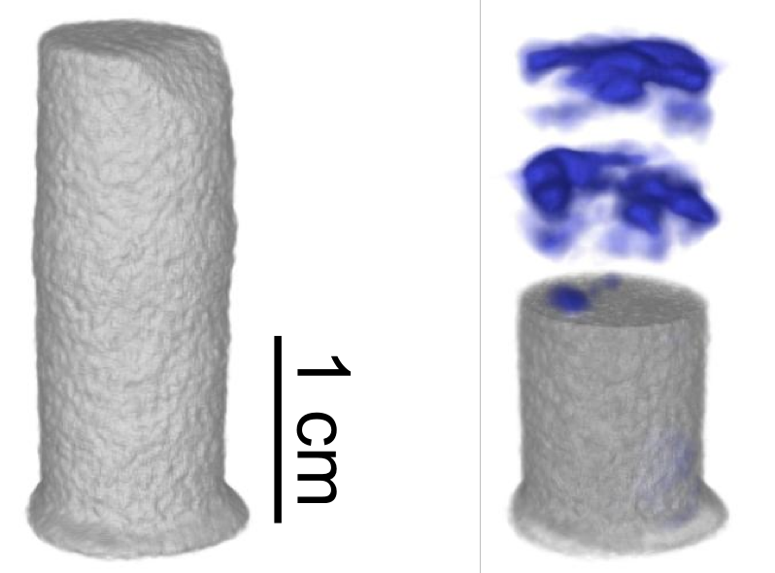
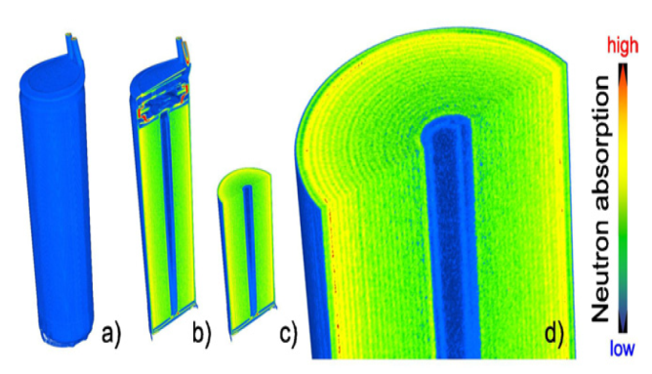
Introduction
Neutron Imaging Examples

Slide 4
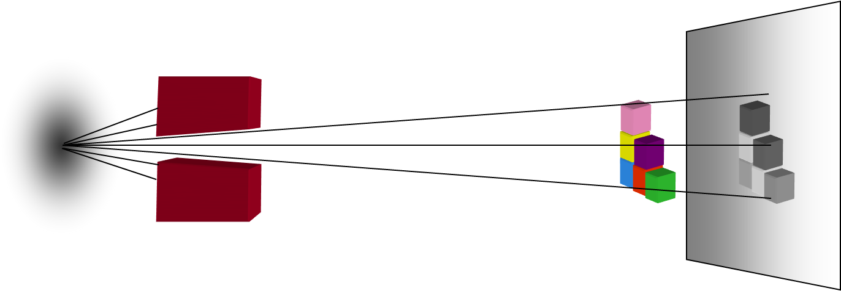
Introduction
The Principle of Neutron Imaging
Diaphragm
Sample
N Source
D
L
Large L/D = High resolution

Slide 5
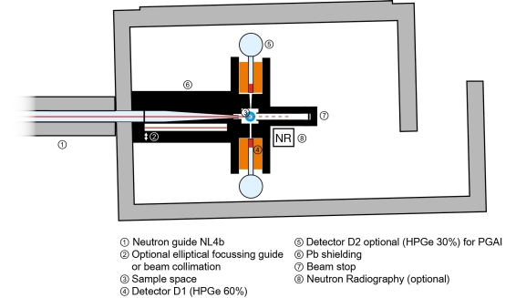
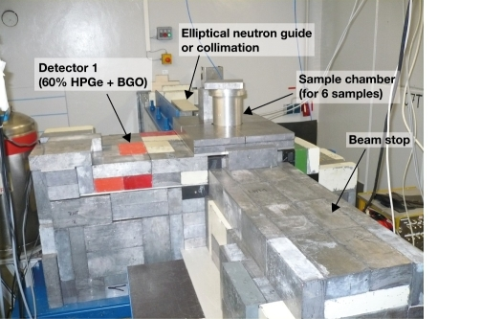
Neutron Imaging Facilities at FRM II
PGAA - Cold Neutron Beam with Eliptical N-Guide Option
PGAA beam line concept

Slide 6
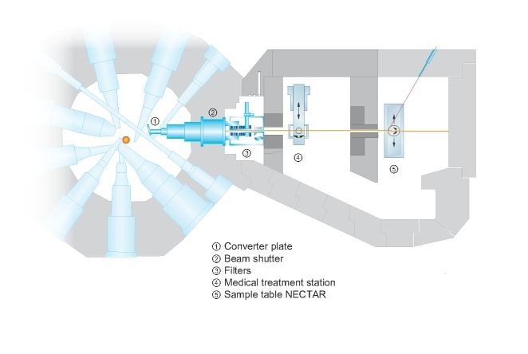
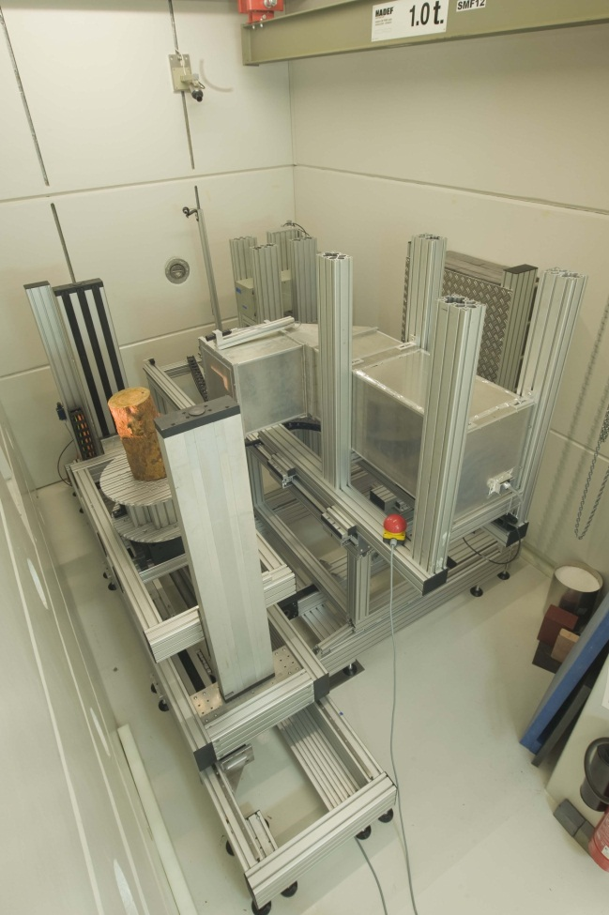
Neutron Imaging Facilities at FRM II
NECTAR - Radiography and Tomography Using Fission Neutrons

Slide 7
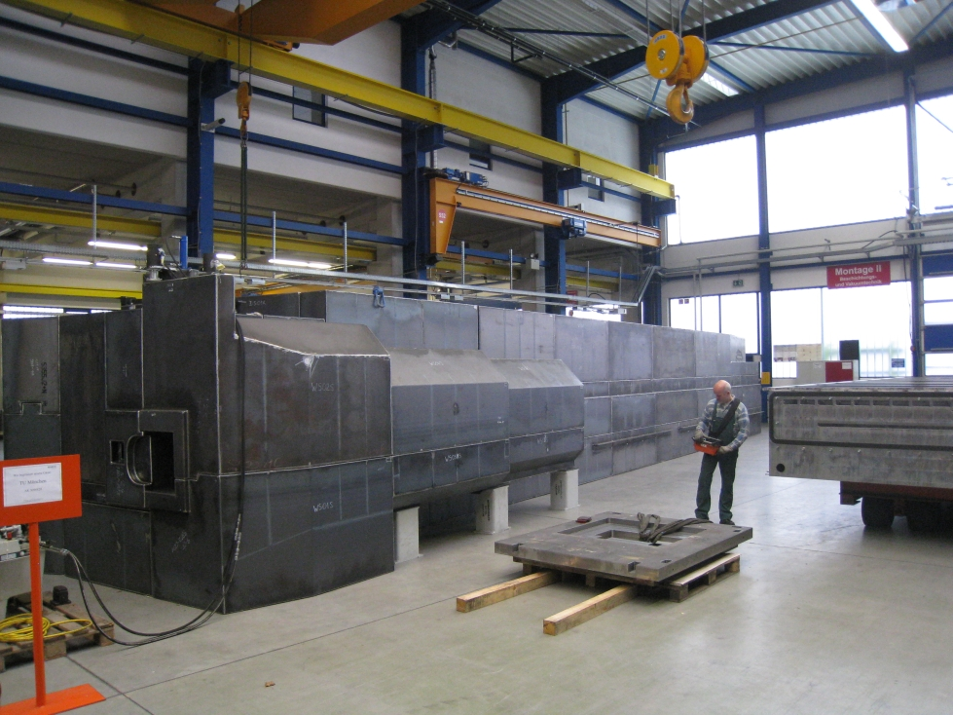
Neutron Imaging Facilities at FRM II
ANTARES - Radiography and Tomography with Cold Neutron Spectrum

Slide 8
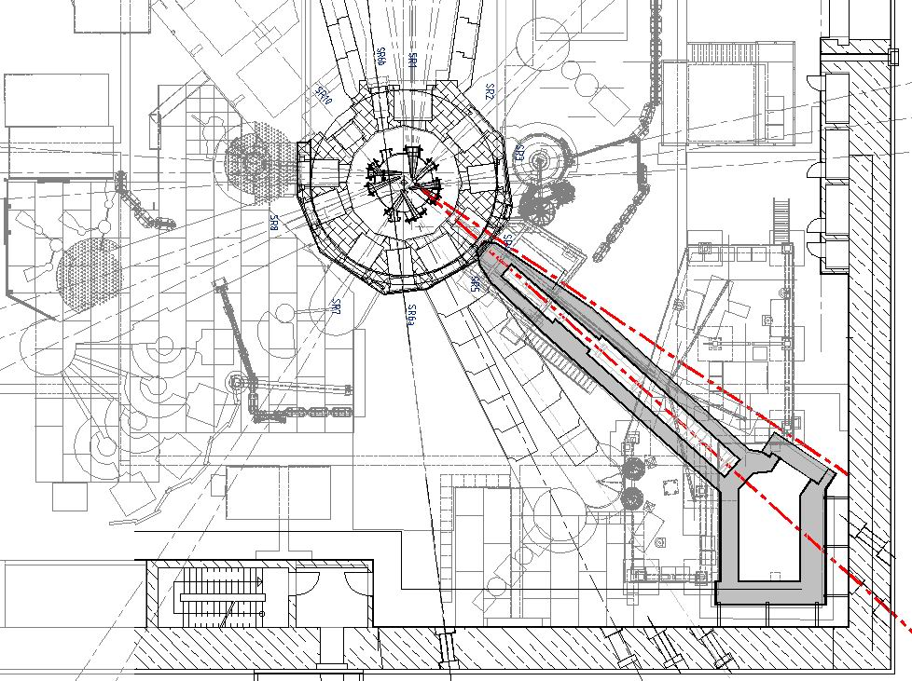
ANTARES
Situation - Experimental Hall at FRM II until 2010
Neutron beam 4a
Neutron beam 4b
ANTARES shielding

Slide 9
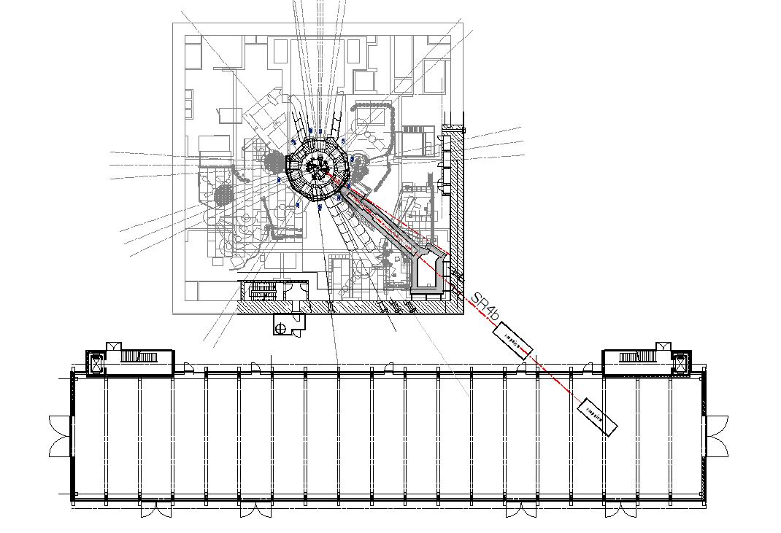
ANTARES
Why a New Facility?
In May 2006, the reactor FRJ-2 at the Jülich Research Center was permanently shut down.
Eight instruments are being transferred to FRM II in Munich to a newly built experimental hall at the east side of FRM II.
The Neutron beam SR4b hosting ANTARES was the only beam with cold-spectrum Neutrons that could be extended from the experimental hall to the new east hall.
ANTARES had to move to the second channel (SR4a).
East hall

Slide 10
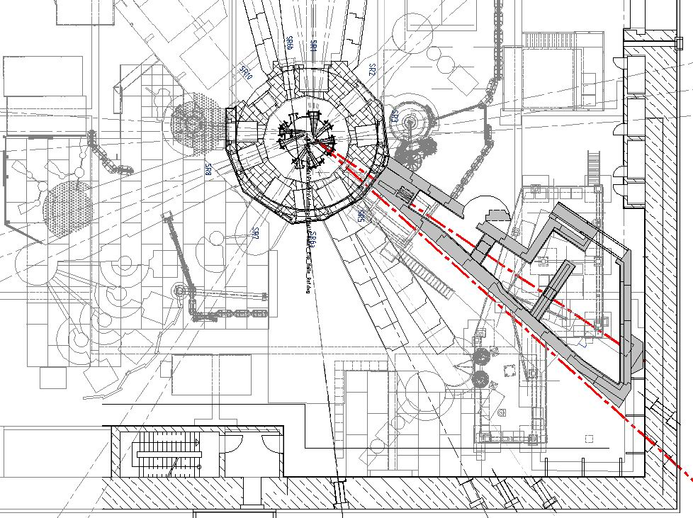
New ANTARES II Facility
Overview
Neutron beam 4a
New ANTARES II facility on SR4a

Slide 11
Comparison
ANTARES I and New ANTARES II

Slide 12
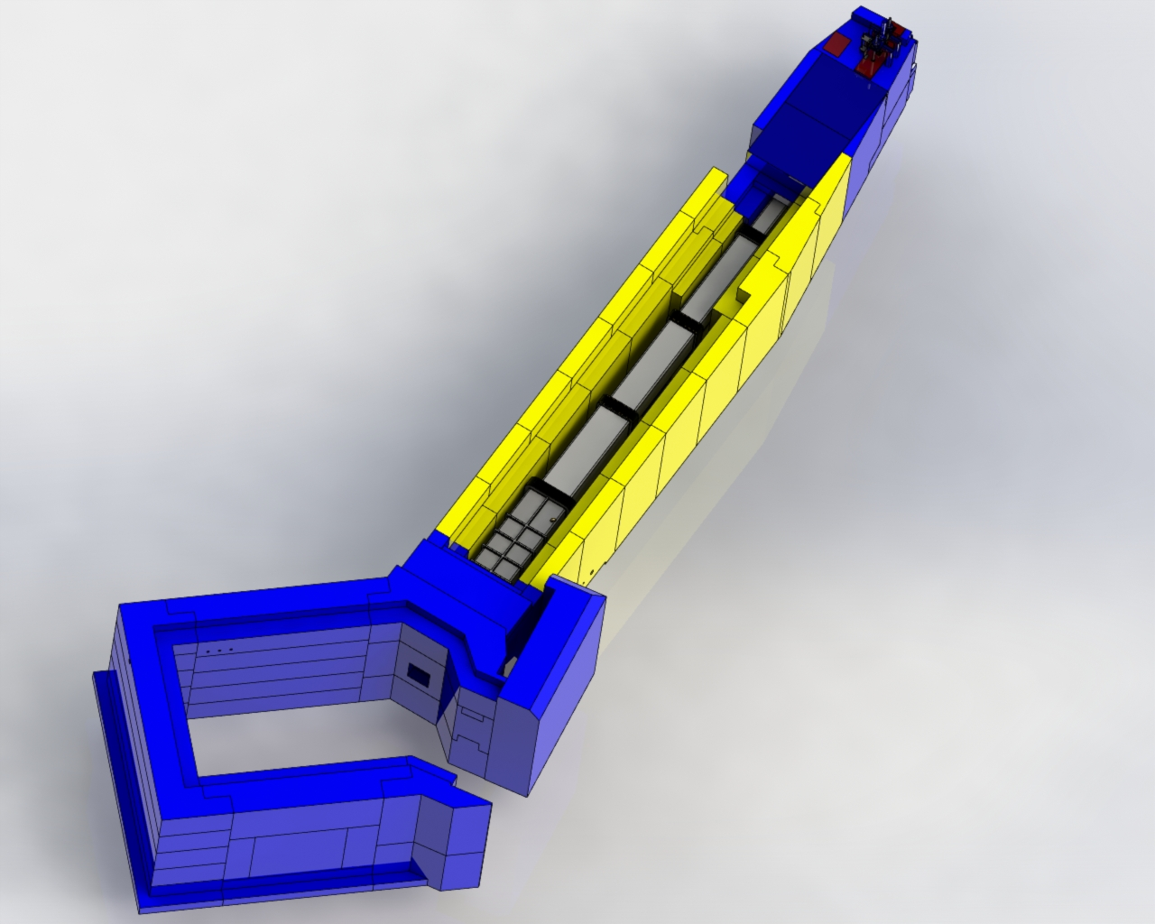
ANTARES I
Concept Overview
Shutter block
Measurement chamber
Evacuated flight tubes

Slide 13
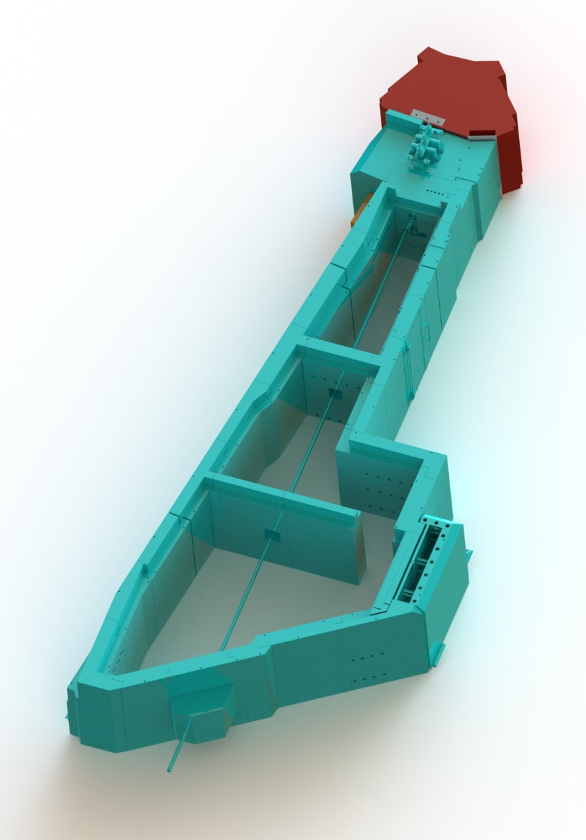
New ANTARES II Facility
New Concept with Three Chambers
Beam accessible along flight path
More possibilities than ANTARES I
Higher flexibility
New & lighter shielding material
Abundant space for experiments & sample environment
All components on rail system
Cooling water & pressurized air supply
Electric supply up to 400V@400A
Reactor biological shield
Shutter block
Chamber 1
Chamber 2
Chamber 3

Slide 14
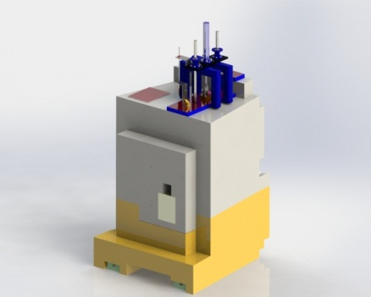
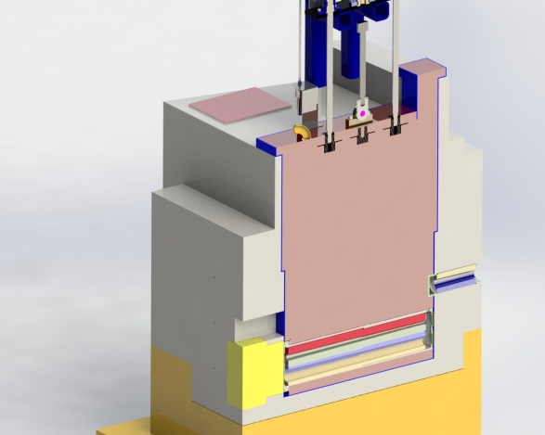
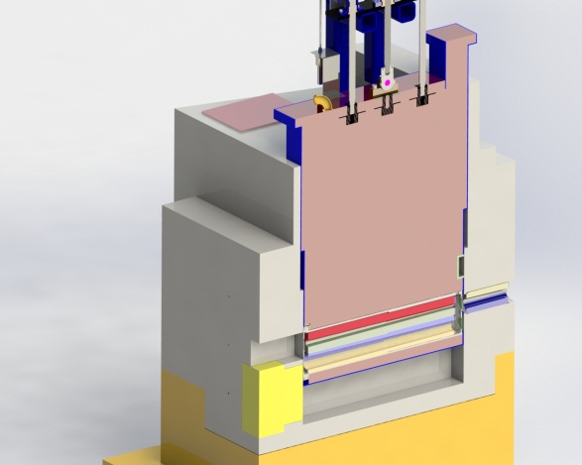
ANTARES I
Shutter Block Concept
Shutter Block
secondary shutter in closed position
Shutter Block
Secondary with collimator in Neutron beam

Slide 15
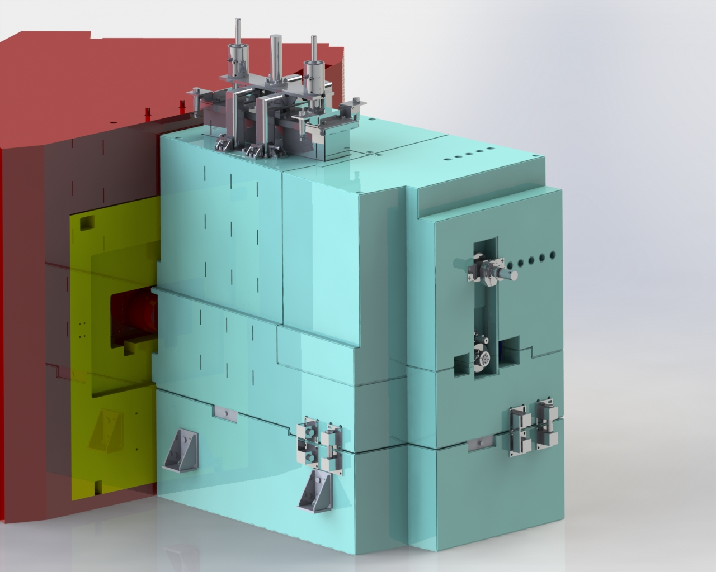
New ANTARES II
Shutter Block Concept
External vertical beam shutter
(fail-safe mechanism)

Slide 16
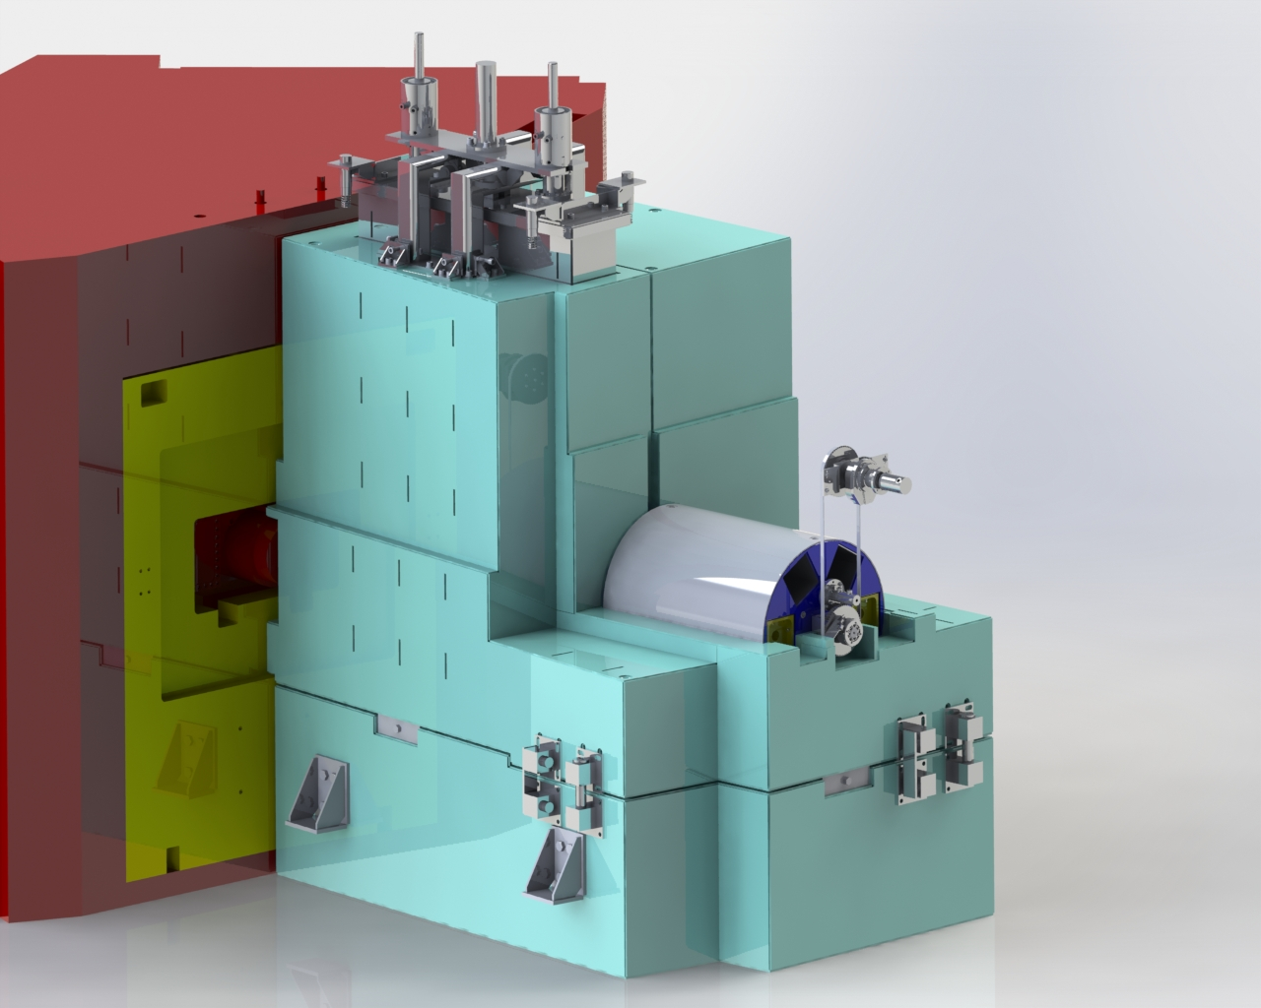
New ANTARES II
Shutter Block Concept
Drum collimator selector

Slide 17
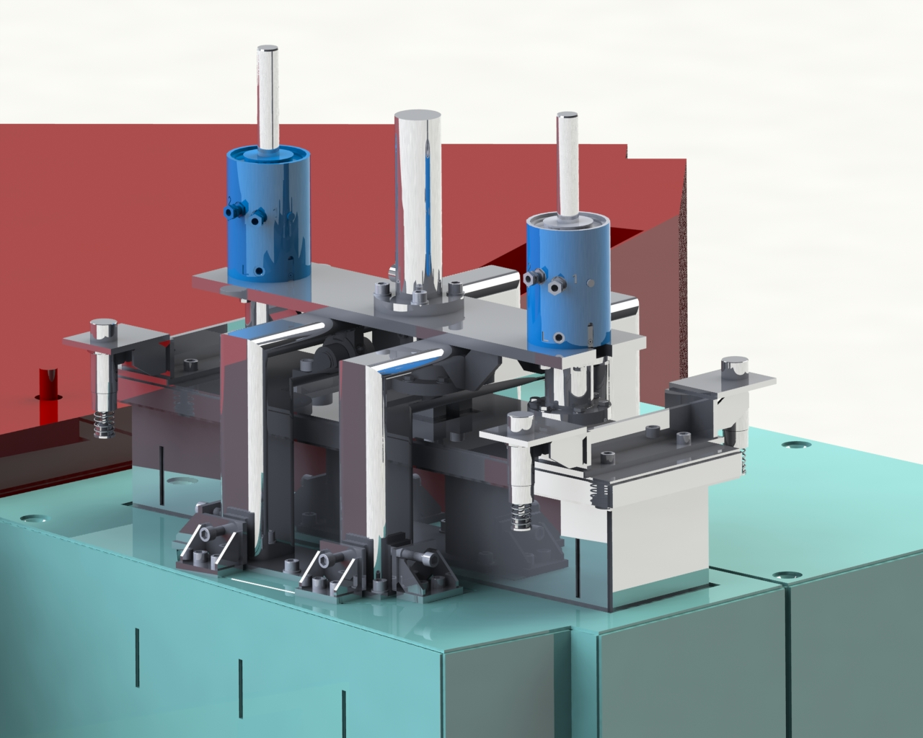
ANTARES I and New ANTARES II
Shutter Block Concept
Notes:
The anular piston keeps the clamping sleeve released by pushing against the set of disc springs.
On zero pressure the clamping sleeve is forced into the cone of the husing by a set of disc springs.

Slide 18
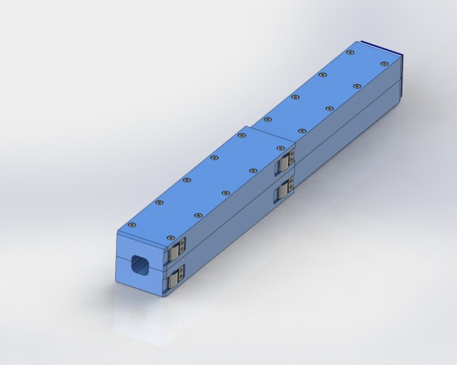
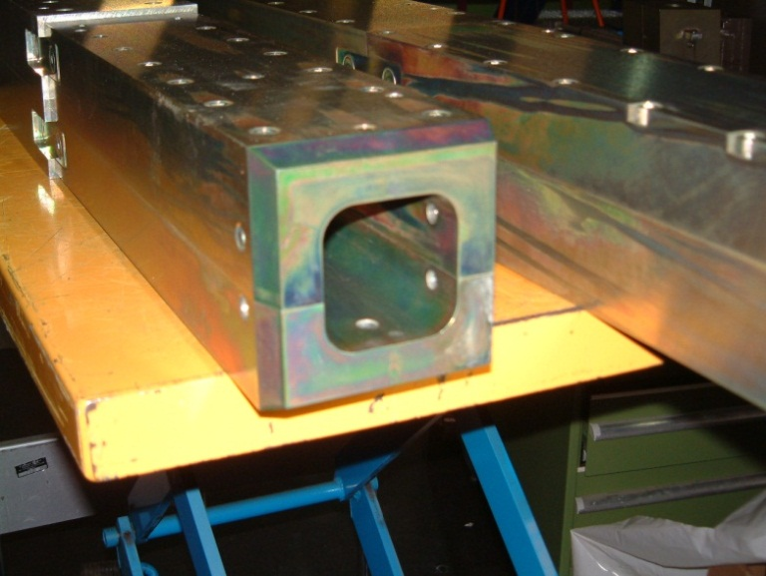
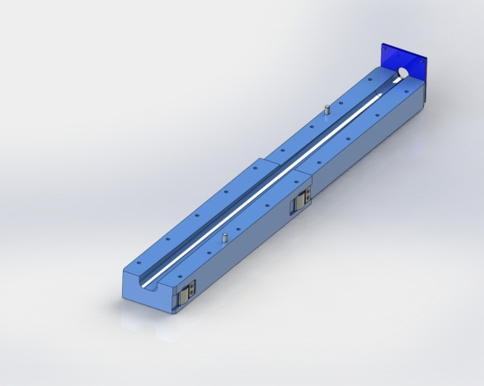
ANTARES I
Collimator Concept

Slide 19
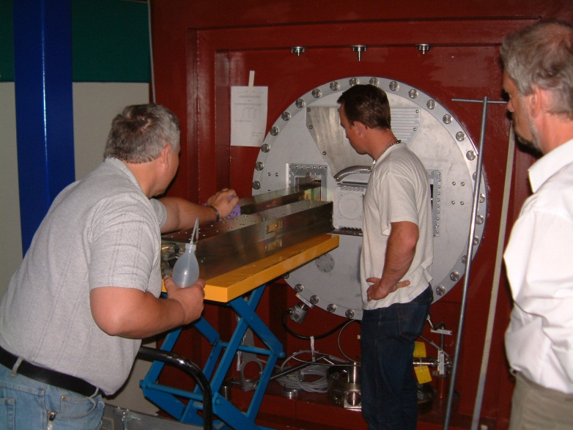
ANTARES I
Easy Job: Fitting Collimator Element into the Beam Tube

Slide 20
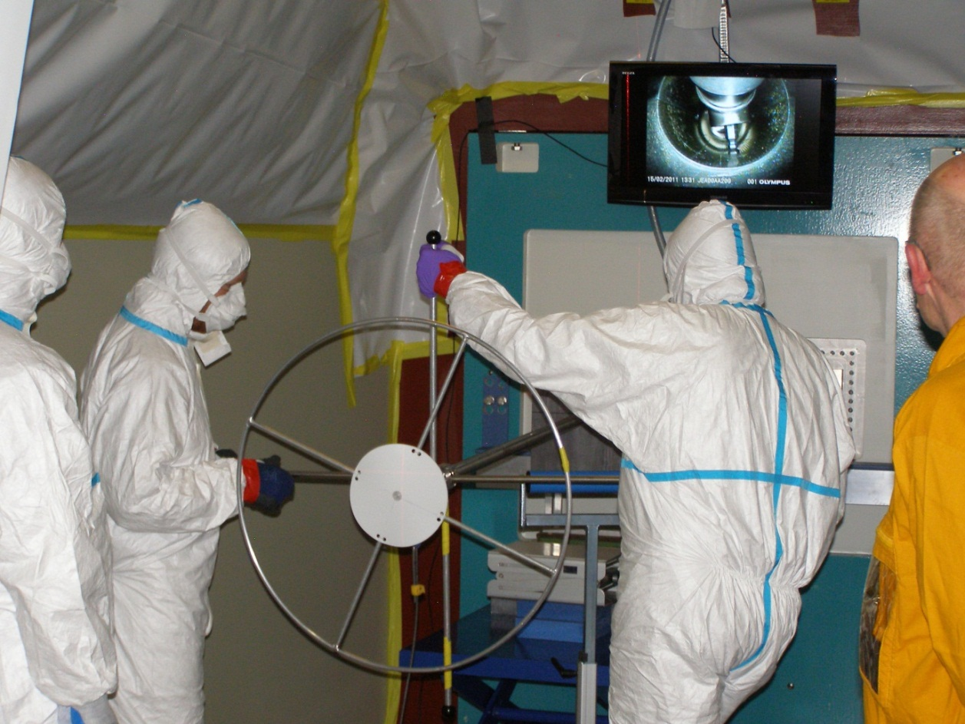
ANTARES I
Not-so-easy Job: Pulling Collimator Element out of the Beam Tube
A dismounting concept had to be developed
Working team had to be trained with mock-ups
Working team needed protection against contamination
Special handling tools had to be developed

Slide 21
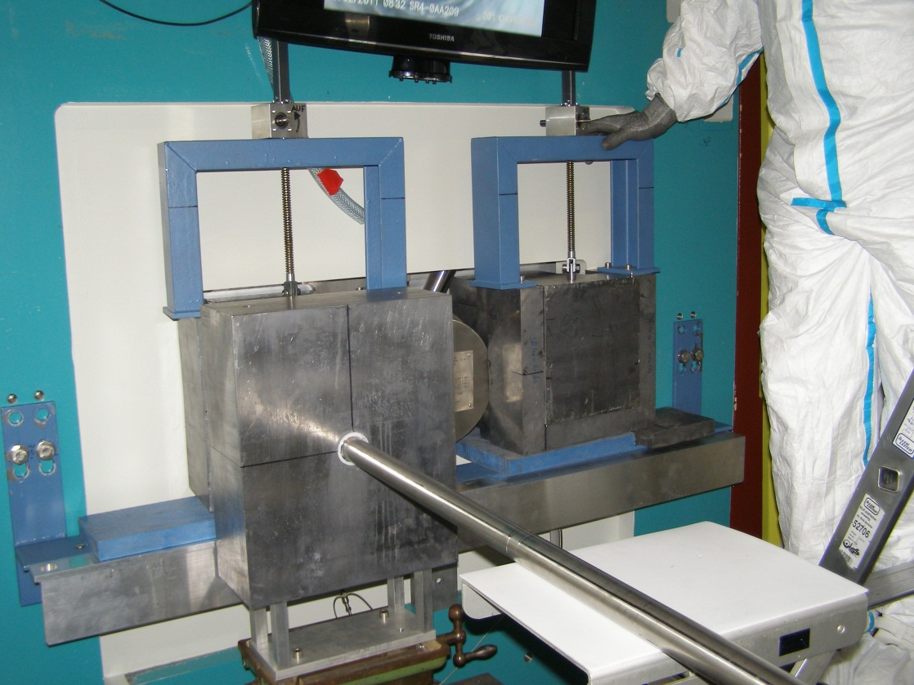
ANTARES I
Not-so-easy Job: Pulling Collimator Element out of the Beam Tube

Slide 22
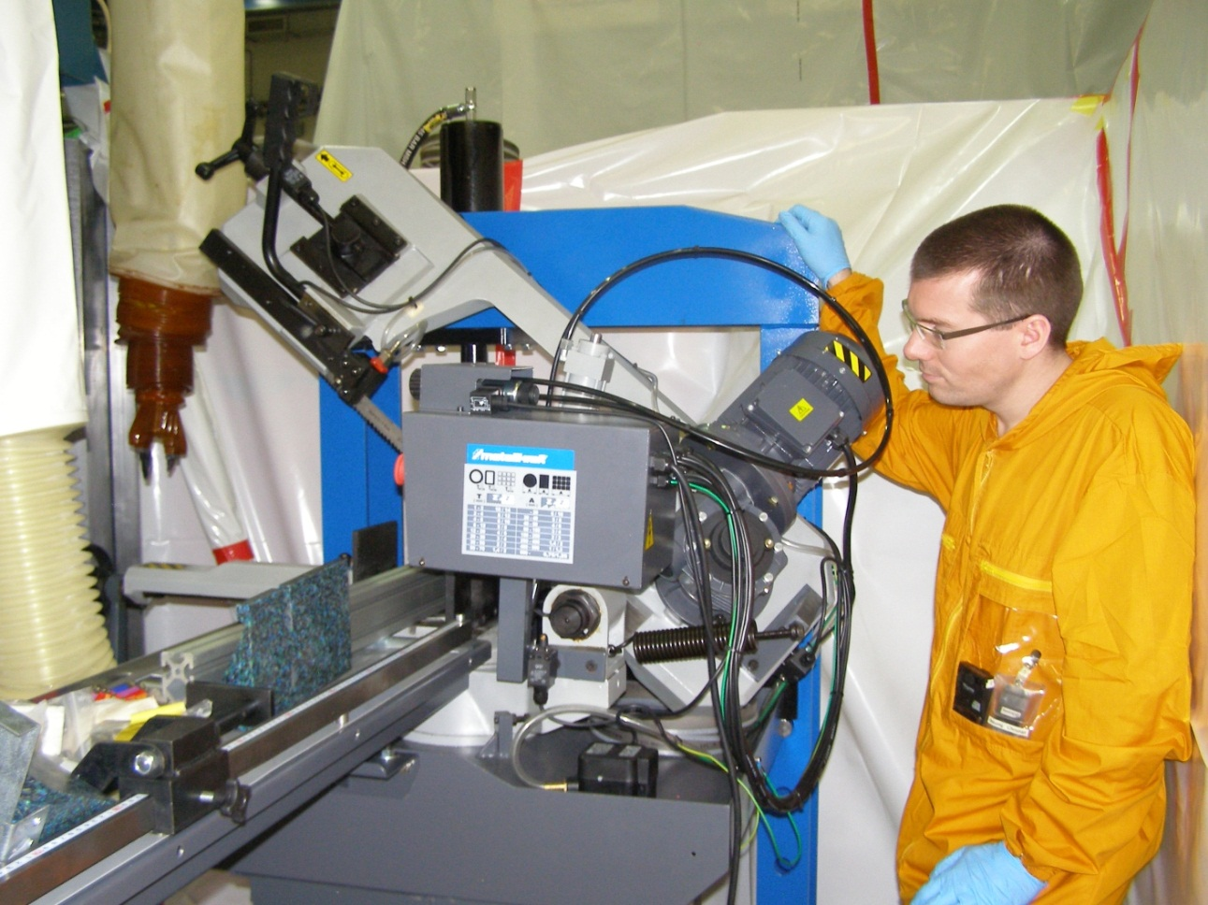
ANTARES I
Not-so-easy Job: Pulling Collimator Element out of the Beam Tube

Slide 23
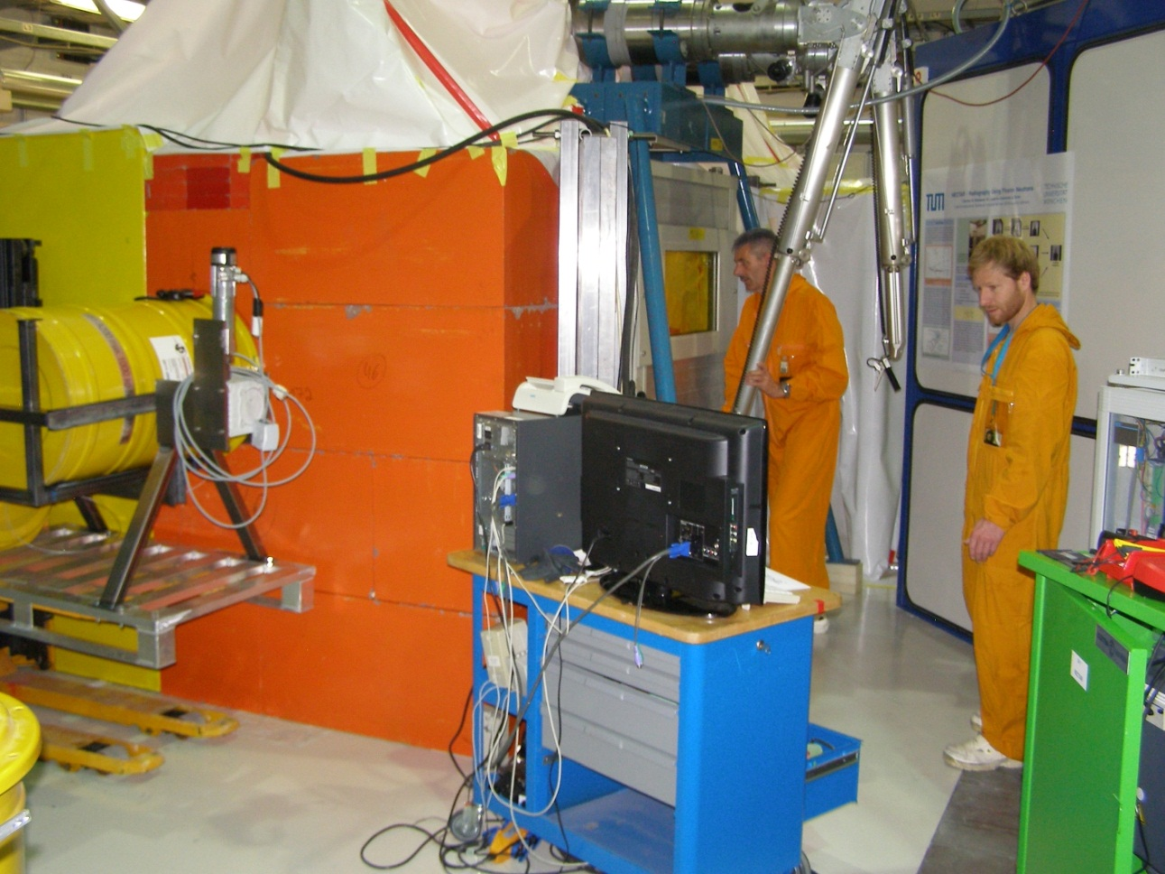
ANTARES I
Not-so-easy Job: Pulling Collimator Element out of the Beam Tube
Hot cell with shielding walls had to be built
Remote manipulation necessary
Yellow barrels for radioactive waste necessary
Surveillance cameras
Special protection measurements for the working team (Gamma dose)

Slide 24
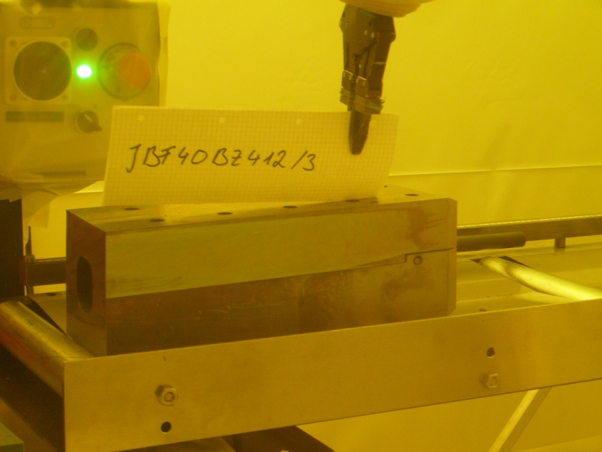
ANTARES I
Not-so-easy Job: Pulling Collimator Element out of the Beam Tube
Collimator parts had to be cut behind lead glass within the hot cell

Slide 25
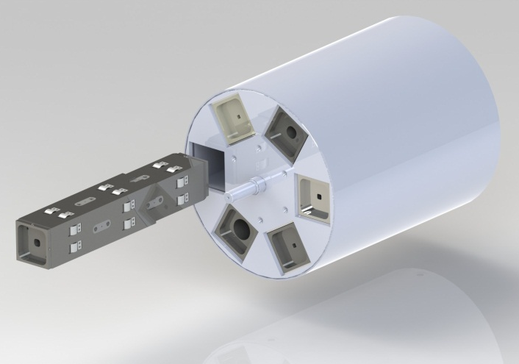
New ANTARES II
Collimator Concept
Pinholes: 2mm… 70m
L/D = 100…. 7,100
Flux: 108 n/cm²s @ L/D = 400
Machined from borated steel
Length: 800 mm

Slide 26
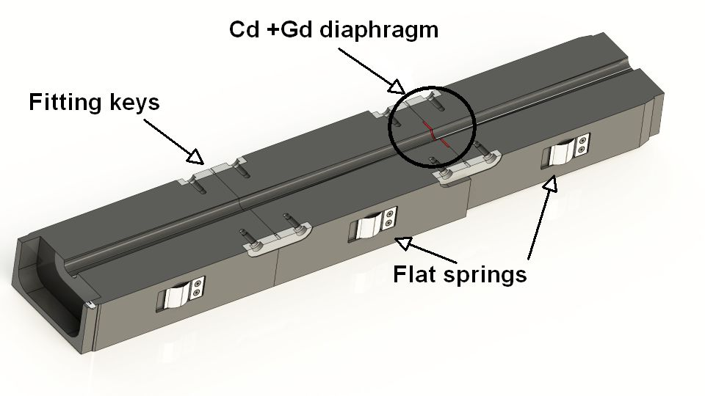
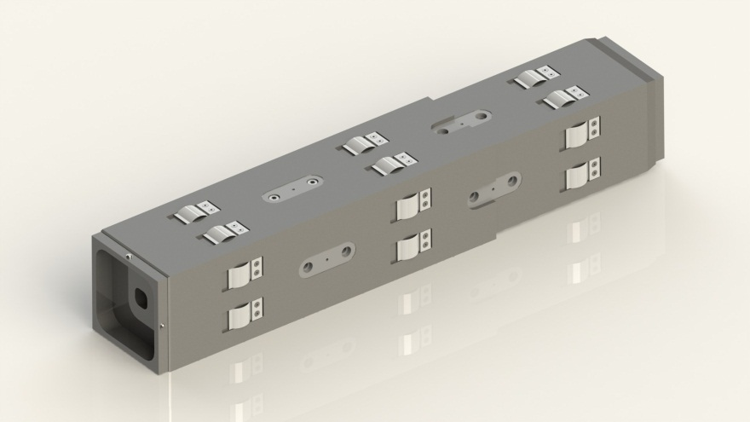
New ANTARES II
Collimator Concept
The new collimators for ANTARES II are manufactured from Borated steel plates as they are used for nuclear power plant shielding.
The cross section of the contained Boron overshadows the iron cross section in order to minimize the activation.

Slide 27
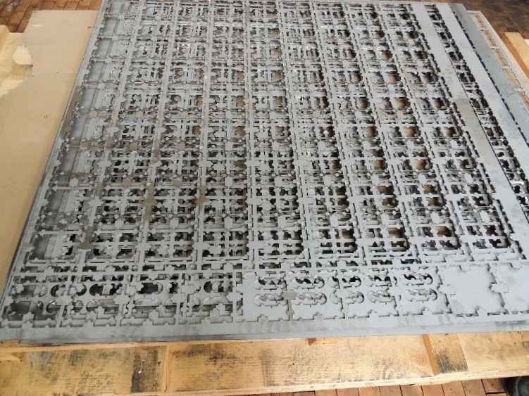
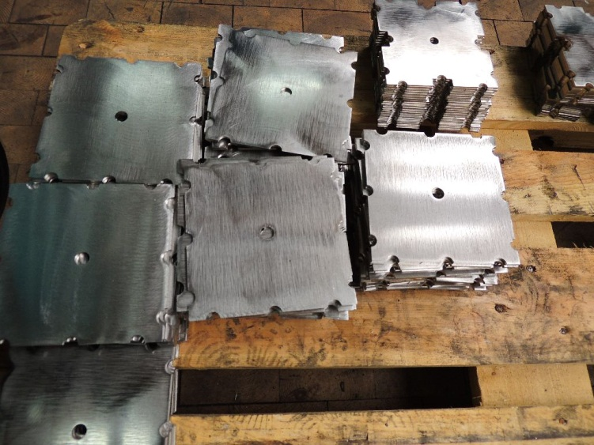
New ANTARES II
Collimator Concept - Manufacturing
For the manufacturing of the new collimators a Steel alloy was used.
An Austrian company produces Borated steel plates that contain up to 1.88 wt% Boron in granular form, encased in the rolling process of steel plates.
Since the Boron is encased during the rolling process, this material is not available as semi-finished blocks, but only as sheet metal with a maximum thickness of 3.4 mm or less.

Slide 28
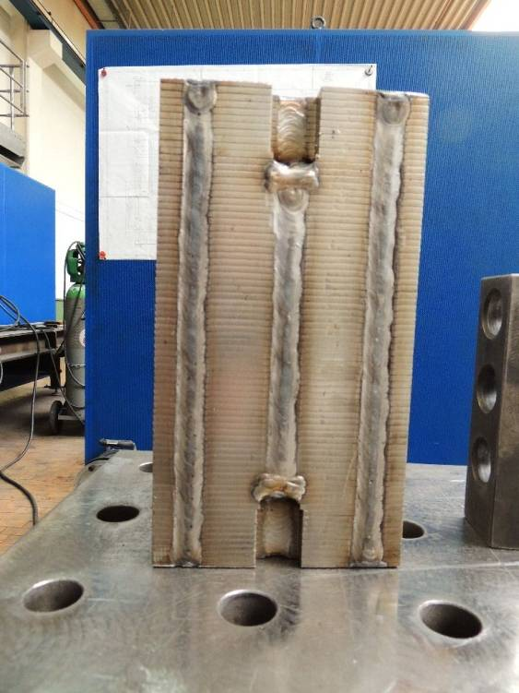
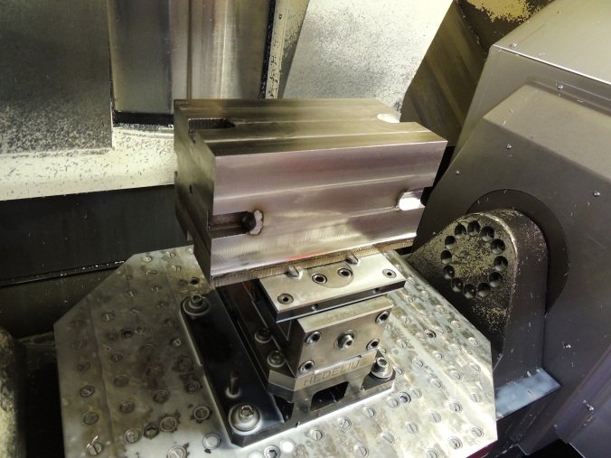
New ANTARES II
Collimator Concept - Manufacturing
The cut-out pieces were stacked and aligned in a press, then welded together in the pre-fabricated grooves, forming a solid block in the process
These blocks were placed in a milling machine and reduced to the required cross-section

Slide 29
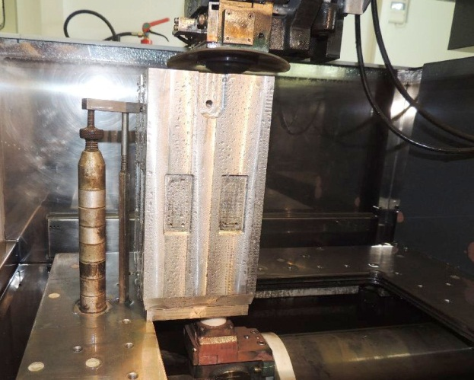
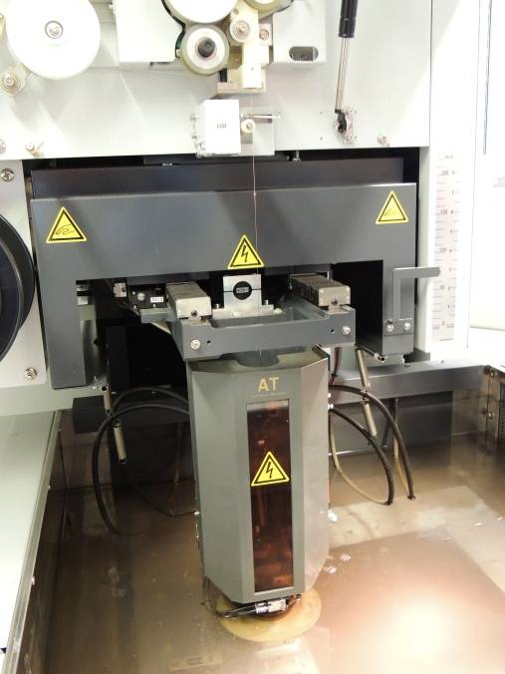
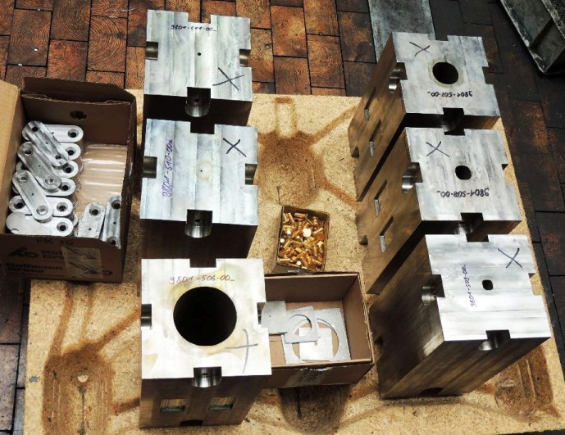
New ANTARES II
Collimator Concept - Manufacturing
To produce the conical channels in the collimators, stepped layering by laser cutting of varying diameter holes had been considered.
Wire-cut electric discharge machining (wire EDM) with a threaded wire was the best way to cut the complicated contours of the pinhole camera projection.

Slide 30
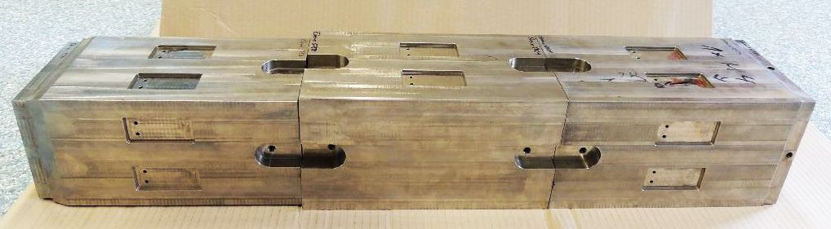
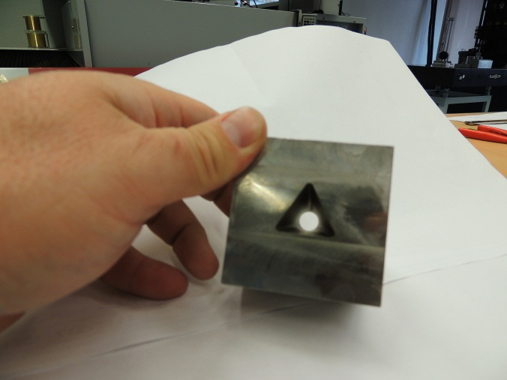
New ANTARES II
Collimator Concept - Manufacturing

Slide 31
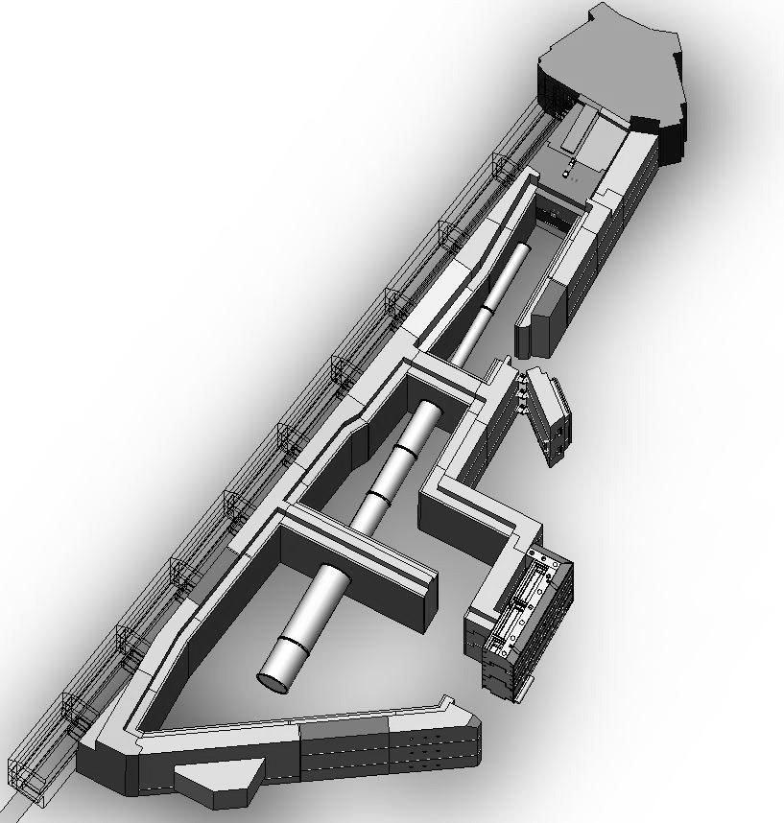
ANTARES I and New ANTARES II
Flight Tube Concepts

Slide 32
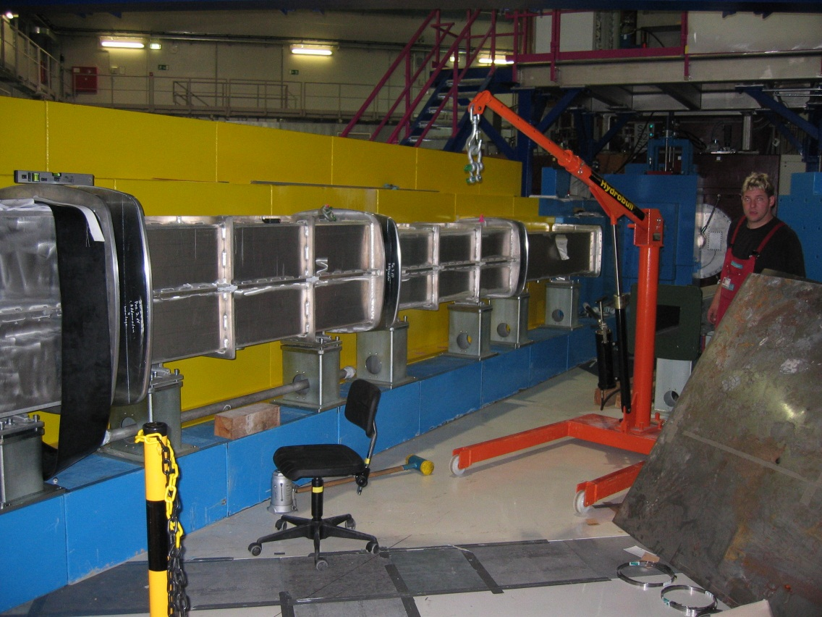
ANTARES I
Fixed Evacuated Flight Tubes

Slide 33
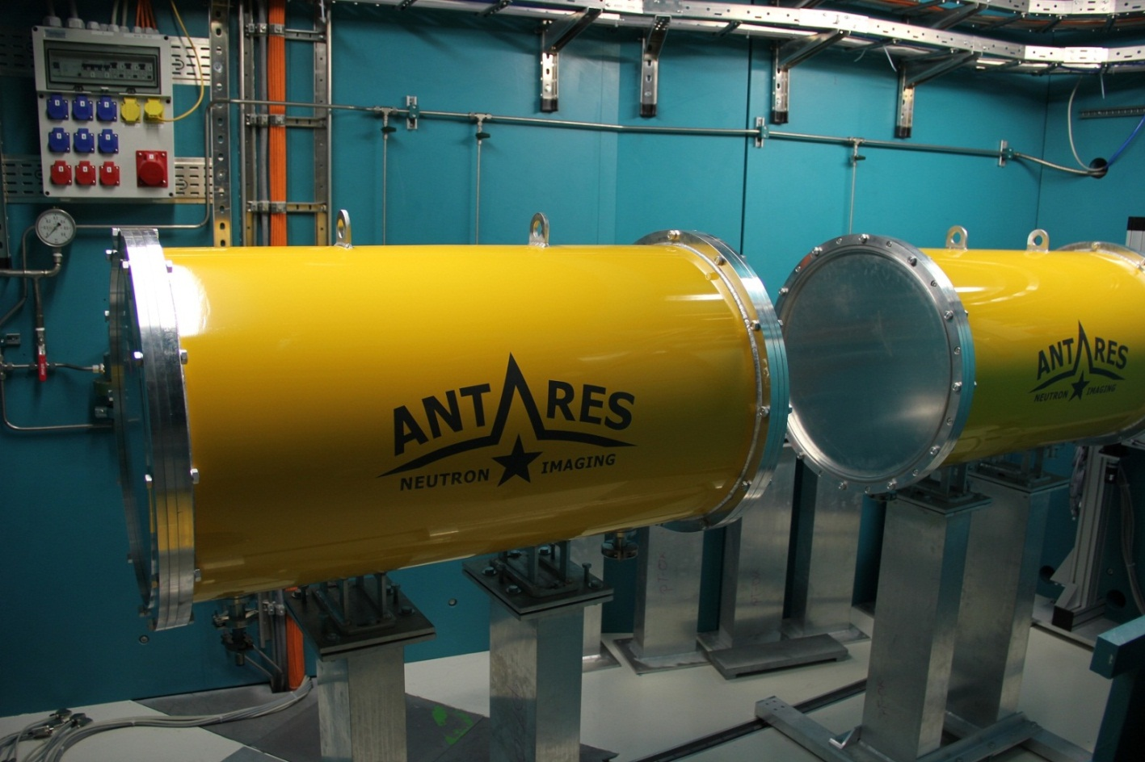
New ANTARES II
He-Filled Flight Tubes
He-filled flight tubes
15mbar
Highly flexible concept for moving, combining parts and removing parts from the flight tube

Slide 34
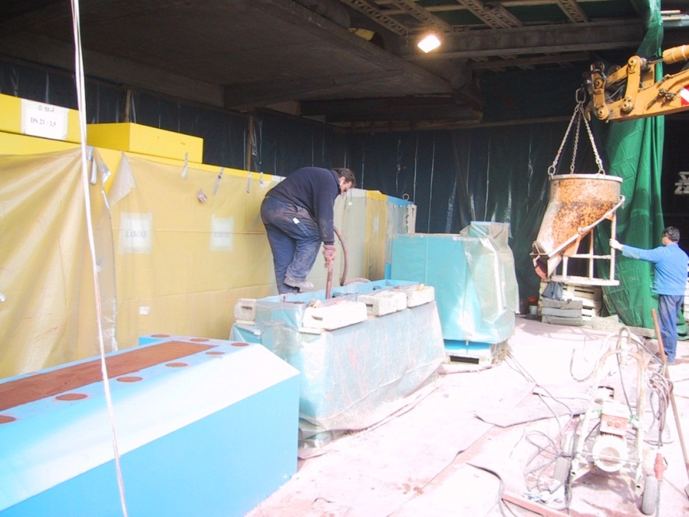

ANTARES I
Shielding Concept
Disadvantages of concrete:
Not all contained elements attenuate Neutron- and Gamma-radiation
Available space at facility may be an issue
Weight of shielding element may be an issue
Processing difficult in winter time
Proper disposal of concrete in steel containers on decommissioning.

Slide 35
New ANTARES II
Shielding Concept
Parameters of new shielding material:
1. A mixture of 60% iron, 35% hydrogen and 5% boron
2. Powder density minimum 80%

Slide 36



New ANTARES II
Shielding Concept
Advantages:
Better shielding properties than heavy concrete
Material doesn’t get solid like concrete
Consistence like wet sand
Can be extracted from shielding containers
Reusable
Cost-efficient

Slide 37
ANTARES II Facility - Innovative Features

Slide 38

New ANTARES II
Beam Formation Area
Separately accessible
Fast shutter
Filters
Double Crystal Monochromator
Velocity Selector
Polarizer
Periscopes

Slide 39

New ANTARES II
Fast Shutter + Filter Wheel

Slide 40

New ANTARES II
Monochromatization – Velocity Selector
Astrium Neutron Velocity Selector
144 lamellae
λ_{min} = 2.95Å
∆λ/λ = 10%
Peak Transmission > 80%
FOV ~ 20 x 20 cm

Slide 41


New ANTARES II
Double Crystal Monochromator
Pyrolytic graphite (002) crystals
Mosaicity 0.7°
∆λ/λ = 1% .. 3%
Wavelength band: 2.7 … 6.5Å
Applications:
Bragg Edges
Texture

Slide 42

New ANTARES II
Periscopes
Neutron periscope can be used to shield background radiation
availability of high m polarizing supermirrors also allows to build a polarizer based on the periscope principle
beam geometry is conserved, contrary to most other polarizers
High beam polarization expected

Slide 43


New ANTARES II
Periscopes
Several periscope prototypes were built and tested at the ANTARES I facility
Neutrons + γ
cold neutrons

Slide 44
New ANTARES II
Low Background Chamber
Chamber with easy access.
Measurement position with high flux.
Measurement position with low background. (Advantage during longtime measurements)
Measurement position with possible large distance between sample and detector. (Advantages for phase contrast and small angle scattering images)
Alternative measurement position for X-ray images with conical beam geometry and high flux.
Chamber 2

Slide 45


New ANTARES II
5-Axis HUBER Sample Manipulator
Absolute encoders
x, y linear stages: travel 400mm
360°rotation
2 goniometers
High precision for small samples
→ Reproducable experiments

Slide 46

New ANTARES II
Large Sample Chamber
For large & heavy samples
Manipulator load capacity: 500kg
Beam size: 350 x 350mm
Same beam properties as old ANTARES
L/D ratio 200 … 7100
Chamber 3

Slide 47




New ANTARES II
Additional Features
Surveillance camera
Rail systems for all components aligned in the beam line
Beam limiter with boron nitrite plates
Interlock system

Slide 48
ANTARES II Facility - Assembly

Slide 49


New ANTARES II
Assembly - Unexpected Problems
Leaks in the welded points of some shielding elements
Problem Solved

Slide 50


New ANTARES II
Assembly - Unexpected Problems
Leaks between charging apertures and cover plates of some shielding elements

Slide 51




New ANTARES II
Assembly - Unexpected Problems
Problem Solved

Slide 52


New ANTARES II
Assembly – Positive Surprises
…accurately to the millimeter.
Smooth moving and positioning of shielding elements weighing 50+ tons with air cushion system..

Slide 53


New ANTARES II
Assembly- Positive Surprises
Easy handling of shielding elements with the support of hydraulic power

Slide 54


New ANTARES II
Assembly – Positive Surprises
Shielding roof elements outside of the crane area could easily be put in defined end position with the help of ball transfer units integrated in the shielding blocks.

Slide 55

New ANTARES II
Assembly – Positive Surprises
….the last shielding element is in place!

Slide 56


New ANTARES II
First images

Slide 57
Lessons Learned
The disassembly and disposal of a facility can be more expensive and complicated than building the facility
The choice of proper materials for components working in Neutron beams is crucial
For such a project, a team of trusted, highly experienced and committed members is necessary
Outlook
The objective is to provide flexible Neutron imaging options to answer the various questions concerning scientific and industrial applications coming from an increasing number of researchers worldwide.
In close co-operation with the users and the experience gained through every project the instruments can be further developed.

